Slide 1

Linear Regression

Slide 2
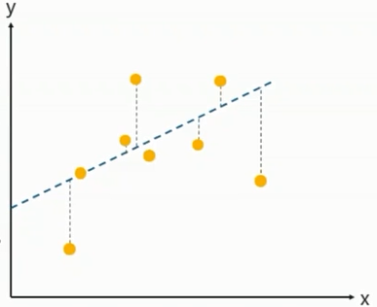
Linear Regression
Linear Regression is a method to predict dependent variable(Y) based on values of independent variable(X). It can be used for the cases where we want to predict some continuous quantity.
Dependent Variable (Y)
The response variable who’s value need to predict
Independent variable(X)
The predicted variable used to
predict the response variable.
Regression Line
dependent variable
y = b + w*x
Independent variable

Slide 3
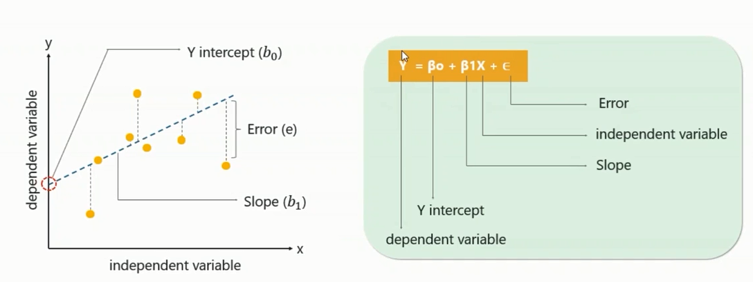
Linear Regression
Mean of y=ȳ
Mean Squared Error
R² ==

Slide 4
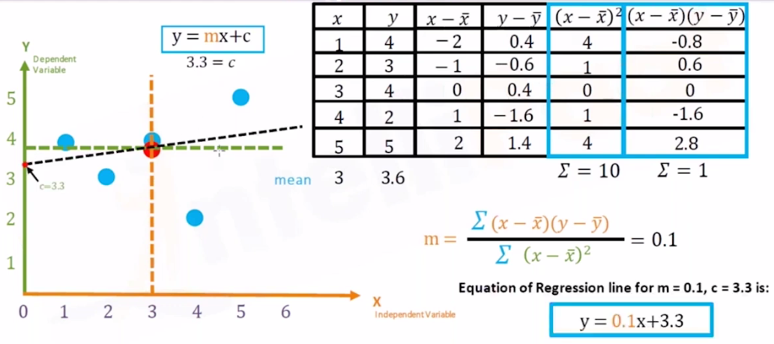
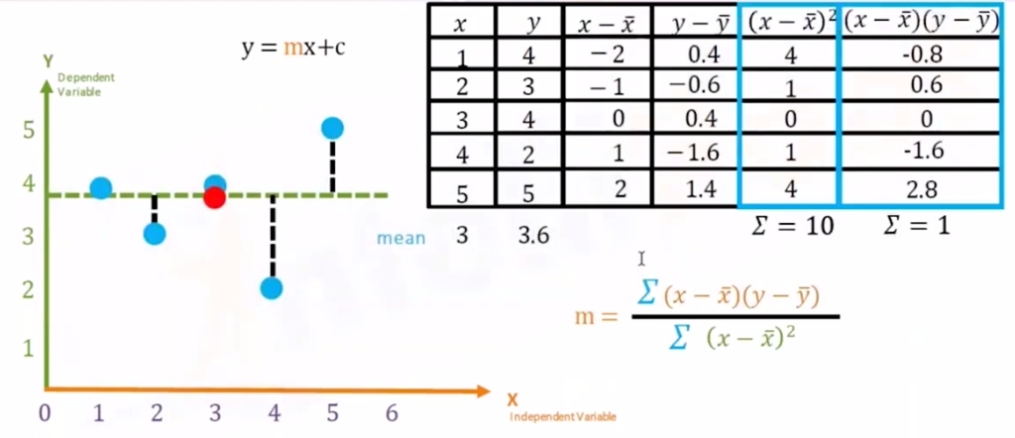
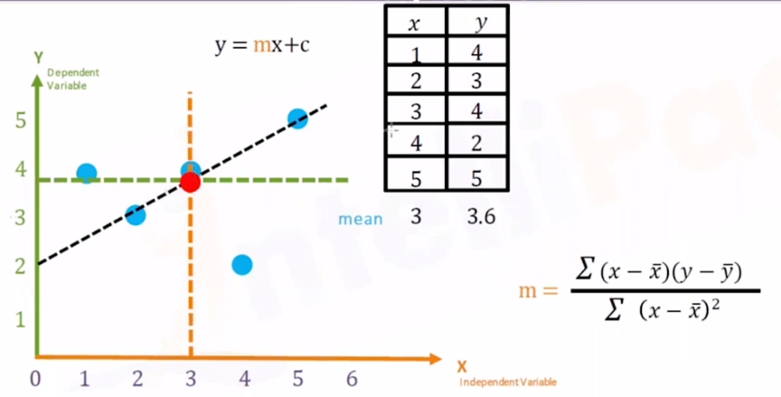
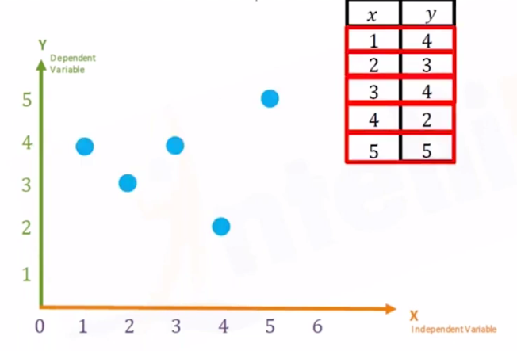
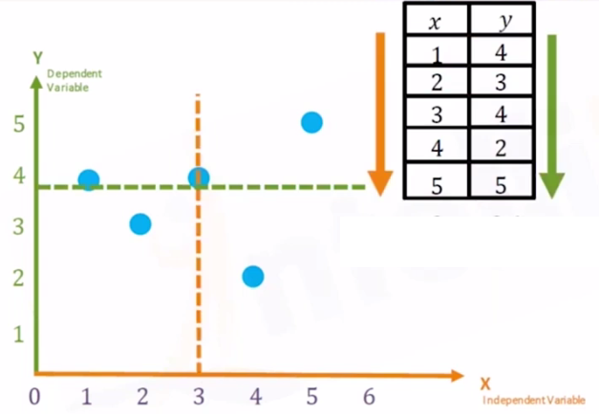
Linear Regression - Example
Mean:x̅ =3
Mean:y̅ =3.6

Slide 5
THANK YOU

